Slide 1
Packets and Sockets 📦
Discussion 2
CS 168, Summer 2025 @ UC Berkeley
Slides credit: Sylvia Ratnasamy, Rob Shakir, Peyrin Kao, Iuniana Oprescu
Notes:
Slides template credit: Josh Hug, Lisa Yan

Slide 2
Logistics
Project 1A: Basic Traceroute
Deadline: Thursday, June 26th (you can still file an extension!)
Project 1B: Traceroute Error Handling
Deadline: Thursday, July 3rd
Still far ahead: Midterm on July 22nd, 7-9pm (put it in your calendar)!

Slide 3
Delays
Transmission Delay
Propagation Delay
Bandwidth Delay
Queueing Delay
Burstiness and Queues
End-to-End Delay
Round Trip Time (RTT)
Notes:
DV lecture last Wednesday, Lecture 5
DV good for small environment; need LS for enterprise scale

Slide 4
Delays
How long does it take for your packet to travel through the network?
It depends on…
how much data you’re sending and the link speed → transmission delay
your distance from the destination → propagation delay
the traffic pattern → queuing delay
Notes:
Transmission – how long it takes computer to actually put bits onto the wire. Depends on how much data you’re sending and the link speed
Propagation – normally speed of light.
Queueing – the traffic pattern. Routers are usually receiving/sending many packets on many different connections simultaneously, and this can slow down the network.

Slide 5
Transmission Delay
How long it takes for the all bits in the packet to get on the wire
The time between when the first and last bits enter the link
Limited by the bandwidth
Bandwidth: Number of bits you can send through a wire per unit of time
Propagation Delay
Bandwidth
Capacity = Delay × Bandwidth
Notes:
Transmission – how long it takes computer to actually put bits onto the wire. Depends on how much data you’re sending and the bandwidth
Propagation – normally speed of light.
Queueing – the traffic pattern. Routers are usually receiving/sending many packets on many different connections simultaneously, and this can slow down the network.

Slide 6
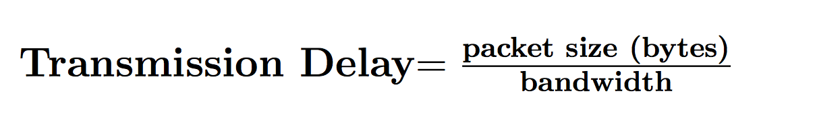
Transmission Delay: Formula
Usually bits/second
Notes:
Transmission delay depends on packet size: the more data you have to send, the longer it’s gonna take to put that data onto the wire. You can only put so many bits onto the wire per second

Slide 7
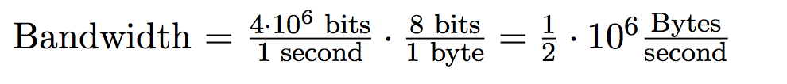
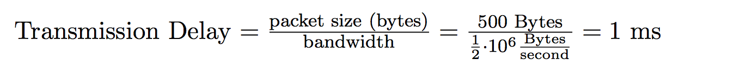
Transmission Delay: Example
Propagation Delay
Bandwidth = 4Mbps
Capacity = Delay × Bandwidth

Slide 8
Propagation Delay (latency)
End-to-end transmission time of one bit
Depends on the length of the link
Limited by the speed of light (propagation speed of link)
Does NOT depend on the size of the packet
Propagation Delay
Bandwidth
Capacity = Delay × Bandwidth
Notes:
Technically it is the speed of light in whatever material the signal is going through

Slide 9

Propagation Delay: Formula

Slide 10

Propagation Delay: Example
speed of light
Propagation Delay
Bandwidth
Capacity = Delay × Bandwidth

Slide 11
Measuring Packet Delay with Timing Diagrams
Packet Delay = Transmission Delay + Propagation Delay
Packet Delay = (Packet Size / Bandwidth) + Propagation Delay
Bandwidth: 1,000,000 bps
Delay: 0.001s
A
B
t = 0s
t = 0.000001s
Transmission Delay
t = 0.001001s
800-bit packet
t = 0.000800s
Propagation Delay
t = 0.001800s
Notes:
f you're
50:30
really looking for the formula roughly speaking this is how we computed it so this is the math that we did so we took
50:36
the packet size that was 800 bits and we divided it by the bandwidth so this
50:42
number in red gave us 800 millionth of a second basically tells us when the last
50:48
bite shows up so maybe another way of thinking it of it is one over bandwidth is how long it takes to send one bit and
50:55
you have packets size number of bits so in total if each one takes one over bandwidth to send and you have packet
51:02
size number of bits the total amount of time it will take to just get everyone in the pipe is Packet size over
51:08
bandwidth and that's this time right here this is the amount of time it takes to just get everyone into the pipe
51:14
regardless of what happens on the other side so the sender has to get until T equals 800 millionth of a second just to
51:22
get everyone into the pipe and this term actually also has a special term we call it transmission delay it's the amount of
51:29
time it takes just to shove everyone in the pipe regardless of what time they actually show up on the other side and
51:35
because this is the time it takes to just get everyone in the pipe by the time the last person enters the pipe or
51:41
the last bit we also have to wait one more propagation delay for that last bit to exit so at the time the last bit
51:48
shows up wait one more propagation delay the last bit exits the pipe and that gives us our final answer so in total
delay comes from two sources one is the transmission delay and it's affected by packet size and bandwidth the more
52:01
packets you have the longer it takes to shove everyone in the pipe and the narrower the packet the pipe is the
52:07
longer it takes to shove everyone into the pipe that's the bandwidth and the second term is propagation delay the
52:13
longer the pipe is the longer it takes for packets to show up and we have one term of propagation delay at the end for
52:19
the last packet to show up all the other packets show up earlier so we don't have to add them in this
52:25
calculation that is is to show up up here so if you really needed the magic
52:30
formula it's this but be ready to draw the timing diagrams to really apply your
52:37
knowledge

Slide 12
Pipe Diagrams
Pipe diagram shows the bits on the link at a frozen moment in time.
Height = bandwidth. How many bits we can put in the pipe per unit time.
Width = propagation delay. How long it takes for bits to travel through the pipe.
Area = bandwidth-delay product. How many bits fit in the pipe at a given instant.
Now that we know the propagation delay, we can tell how many bits are “in flight” (on the link) at any time
Bandwidth: 5 bps
Delay: 7s
A
B
Bandwidth
Propagation Delay
Notes:
in real life what they really care about is the
1:05:41
rectangle itself they want to draw this rectangle as a visual representation of
1:05:46
the pipe so that they can analyze what fits in the pipe at any given time and the way that they draw this pipe is or
1:05:53
sorry this pipe yeah H the way that they draw this pipe is based on the rectangle
1:05:58
and the rectangle is based on the two properties that we already talked about so they're going to draw this pipe using
1:06:05
the bandwidth to determine the height and remember we talked about this earlier the bandwidth tells us how many
1:06:11
bits we can fit in the pipe so the reason why I added this crazy animation is because I wanted to show you that if
1:06:17
you increase bandwidth what happens the rectangle gets taller and if the rectangle gets taller what happens it
1:06:24
means more of these bits can line up to enter the pipe at any given unit of time
1:06:30
that's why bandwidth represents the height of this rectangle so the thing that always confuses people is they say
1:06:36
why is bandwidth the height well one intuitive way of saying it is we talked about the water pipe the bandwidth tells
1:06:41
us how wide the pipe is another way of seeing it is if you look at this diagram it tells us that if the bandwidth is
1:06:48
increased it means that you can stack more of these dots which represent bits and more of the bits can enter at any
1:06:54
given time that is exactly what it means to have higher bandwidth that's why the height is determined by the
1:07:00
bandwidth and the width tells us the propagation delay again it's kind of like the water example the width tells
1:07:07
us how long the pipe is and how long it takes for a single drop of water to travel through the pipe but we can see
1:07:13
that through our little animation as well that if you make this rectangle longer these bits are going to have to
1:07:18
March for more time steps before they can exit on the other side and just like we saw earlier bandwidth times
1:07:25
propagation delay if you multiply these two terms together you get the area of this rectangle which is the capacity of
1:07:31
this pipe and again the animation shows us that this is indeed the capacity of the pipe the area of this rectangle
1:07:39
because the bigger this rectangle is whether you make it taller or wider the bigger this rectangle is the more dots
1:07:45
or bits you can fit into this pipe so hopefully with these dots I've convinced you that the pipe diagram is really just
1:07:53
a rectangle where the bandwidth is the height and the propagation delay is the width and the dots are really just there
1:07:59
for clarity but the rectangle is what people really care about when they draw
1:08:05
these and

Slide 13
Packets might have to wait before they can be transmitted…

Slide 14
Transient Overload
What happens if two packets arrive at the router simultaneously?
Can't process both at the same time! Router must queue one for later.
When there are no incoming packets, router can drain the queue.
This is called transient overload, and it's fairly common.
Need a queue!
A4
A3
A2
A1
Router
B2
B1
B3
Notes:
so take a look at
1:19:39
this picture the router has two packets arriving at the exact same time so in this pipe diagram Frozen in Time A1 and
1:19:47
B1 are both about to arrive at the router at the same time they're right there next to the router and on the next
1:19:53
time step they're both going to arrive well that's a problem because this router can't handle two packets at once
1:20:00
can only handle one packet at a time it looks at the packet thinks about where it needs to go forwards the packet so if
1:20:06
this router can only handle one packet at a time what happens if it suddenly gets two at once well it's a problem and
1:20:12
the solution is the router is going to keep a que and the que basically says here are some packets that I've received
1:20:18
but I have not processed so I'm going to save them for processing later and that's actually totally fine happens all
1:20:25
the time in the internet

Slide 15
Queuing Delay
How long the packet waits to get transmitted on the wire
Happens only when arrival rate is greater than transmission rate
More packets are arriving than are getting transmitted
Need a queue!
A4
A3
A2
A1
Router
B2
B1
B3
Notes:
so take a look at
1:19:39
this picture the router has two packets arriving at the exact same time so in this pipe diagram Frozen in Time A1 and
1:19:47
B1 are both about to arrive at the router at the same time they're right there next to the router and on the next
1:19:53
time step they're both going to arrive well that's a problem because this router can't handle two packets at once
1:20:00
can only handle one packet at a time it looks at the packet thinks about where it needs to go forwards the packet so if
1:20:06
this router can only handle one packet at a time what happens if it suddenly gets two at once well it's a problem and
1:20:12
the solution is the router is going to keep a que and the que basically says here are some packets that I've received
1:20:18
but I have not processed so I'm going to save them for processing later and that's actually totally fine happens all
1:20:25
the time in the internet

Slide 16
Persistent overload
Persistent overload: Not enough capacity to handle the incoming packets!
Queue won't help us. If the queue fills up, the router must drop packets.
How do we solve persistent overload?
Operators can detect the overload and (manually) upgrade the link.
Routers can tell the senders to slow down.
A7
A6
A5
A4
Uh oh...
A3
A2
A1
Router
B2
B1
B4
B3
B6
B5
B7
Notes:
but sometimes the router cannot handle
5:02
all the incoming load so if the two pipes that are incoming look like this well this router is doomed it's not
5:09
going to be able to handle all of these packets no matter how much it tries to
5:14
put packets in a queue it's just not going to have enough bandwidth to send out this many packets over a single link
5:22
so this router is in trouble the que is going to build up and build up and eventually the queue itself is going to
5:28
exceed some limit and become to full and at that point this router simply has to give up and it's going to start dropping
5:35
packets which means it receives a packet and just ignores it doesn't get forwarded the packet just gets lost and
5:42
stuff like this by the way is why we said that the internet has best effort at layer three it's because we design
5:48
routers like this and the way that we design routers which is that we allow them to drop packets in cases like this
5:55
is consistent with our design that we said routers only have to offer best effort service so it's a nice case of
6:02
the design matching the implementation because we said that the Internet only provides best effort well then this
6:08
router is allowed to drop packets if it can't handle them because the internet is best effort so you could have a que
6:16
but the que is not going to help you if you try drawing this out with a que the que itself is going to get packed and to
6:22
full and eventually some of these later packets are just going to get dropped so here we call this persistent overload
6:28
because it's not the case that the router temporarily had a little bit too much to do but later it was able to
6:34
clean out the queue this is the case where the queue is never getting clean we just don't have enough capacity this
6:40
router is just not powerful enough or doesn't have enough processing power doesn't have enough outgoing bandwidth
6:47
to process all the packets that are incoming so this is a problem of not enough capacity it's not a problem of a
6:54
temporary overload that gets solved this is a persistent problem that's why people call persistent overload so how
7:01
do you fix this turns out there's not really a great answer one possible answer is the router itself logs
7:09
somewhere for its operator the person operating this router hey I am not able to send out all the packets I have been
7:15
dropping a lot of things lately you might want to consider upgrading me to a better model give me some more
7:21
processing power connect me to some more links so that I can actually handle all the packets but that's a manual process
7:28
it's not something that the router can just automatically do routers don't upgrade themselves automatically someone
7:34
would actually have to come in and rewire this router or install a better one to handle this kind of load and
7:40
something else we'll see later in the semester is this router might actually be able to send a packet backwards to
7:46
the sender and tell the sender you are sending me too much you need to slow down because I can't handle this kind of
7:53
load and that's something we'll spend a lot of time on when we talk about congestion control but for now I just
7:59
wanted to get the point across that routers take in incoming packets they forward them sometimes there is
8:04
transient overload and sometimes there is persistent overload which we will try and solve a lot
8:12
later any thoughts on this stuff

Slide 17
Burstiness and Queues
How does burstiness affect queuing delays?
Bursty flows tend to increase queuing delay
What happens when the queue is full?
Packets are dropped

Slide 18
Packet Queuing and Life of a Packet
Queues introduce extra delay.
Packet delay = Transmission Delay + Propagation Delay + Queuing Delay.
Life of a packet:
Sender puts payload in a packet, adding headers.
Packet travels along a link.
Packet arrives at a router. Router forwards packet to the next hop.
Packet might be queued or dropped.
Repeat the last step until:
Packet reaches destination.
Packet is dropped.
Notes:
8:18
okay so we actually have to go back now and revisit what a packet does when it
8:24
travels from its source to its destination because remember earlier we said that you send a packet the delay of
8:31
the packet comes from two sources one is the transmission delay that is how long does it take for all of the bits to
8:38
March into the pipe and the propagation delay is how long the pipe is how long does it take for the bits to travel
8:44
across the pipe but there's actually a third term that we've now introduced that we previous previously had not
8:51
thought of which is queuing delay because it could be the case that this packet travels multiple hops to its
8:58
destination and some of the intermediate routers trap the packet in a queue for some time before the packet can get
9:04
forwarded so that actually could introduce additional delay into the time
9:10
it takes to send a packet from a source to a destination so we already saw these
9:15
two terms those are in terms of the link that you have the bandwidth the propagation delay and now we have a
9:21
third term which is the queuing delay and that comes from routers that might have to put this packet in a que so in
9:28
total if you think about what does a packet do from the moment it's created to the moment it's received well the
9:34
sender is the one that creates the packet it wraps the packet around a bunch of headers like we've seen before
9:40
and then it sends the bits of the packet along a link and how long it takes to send the packet along the link depends
9:47
on those two terms eventually the packet arrives at a router and the router has
9:52
to forward the packet closer to its destination so the router says I'm not the Final Destination but the final
9:58
Destin is that way so send it that way so the router is going to forward the packet
10:04
and in doing so the packet might have to wait a little bit in the queue or if this router is totally overwhelmed maybe
10:12
that packet just gets dropped that's also an option and then this just repeats over and over again we get to
10:17
the next router there might be some queuing time the router might drop it and if it doesn't drop then that packet
10:24
gets forwarded to the next router that router cues it for a little bit maybe maybe drops the pack pet forwards it
10:30
again and this repeats over and over again until either the packet reaches its destination because all the routers
10:36
along the path correctly forwarded the packet or the packet got dropped along the way in which case it's not reaching
10:43
its destination the end host will have to do something about that so roughly speaking that is what a packet does from
10:50
the moment it's created to either the moment it drops or the moment it reaches its
10:57
destination any thoughts on this

Slide 19
Round Trip Time (RTT)
The time it for the packet to reach its destination and receive a response
RTT = 2 * (End-to-End Delay)

Slide 20


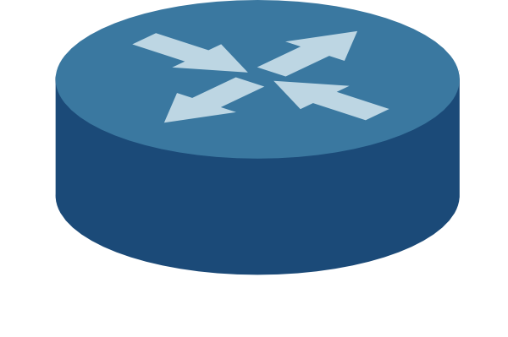
Visualizing end-to-end-delay…
Two packets, back-to-back
Time
Transmission delay
Propagation delay
End-to-end delay of brown packet
Queueing Delay
Transmission delay
Propagation delay

Slide 21
Statistical Multiplexing
Statistical Multiplexing
Layers
Sockets
Notes:
DV lecture last Wednesday, Lecture 5
DV good for small environment; need LS for enterprise scale

Slide 22
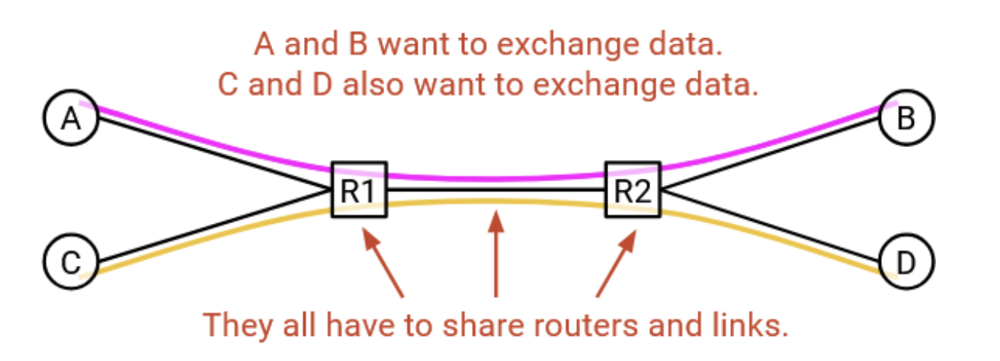
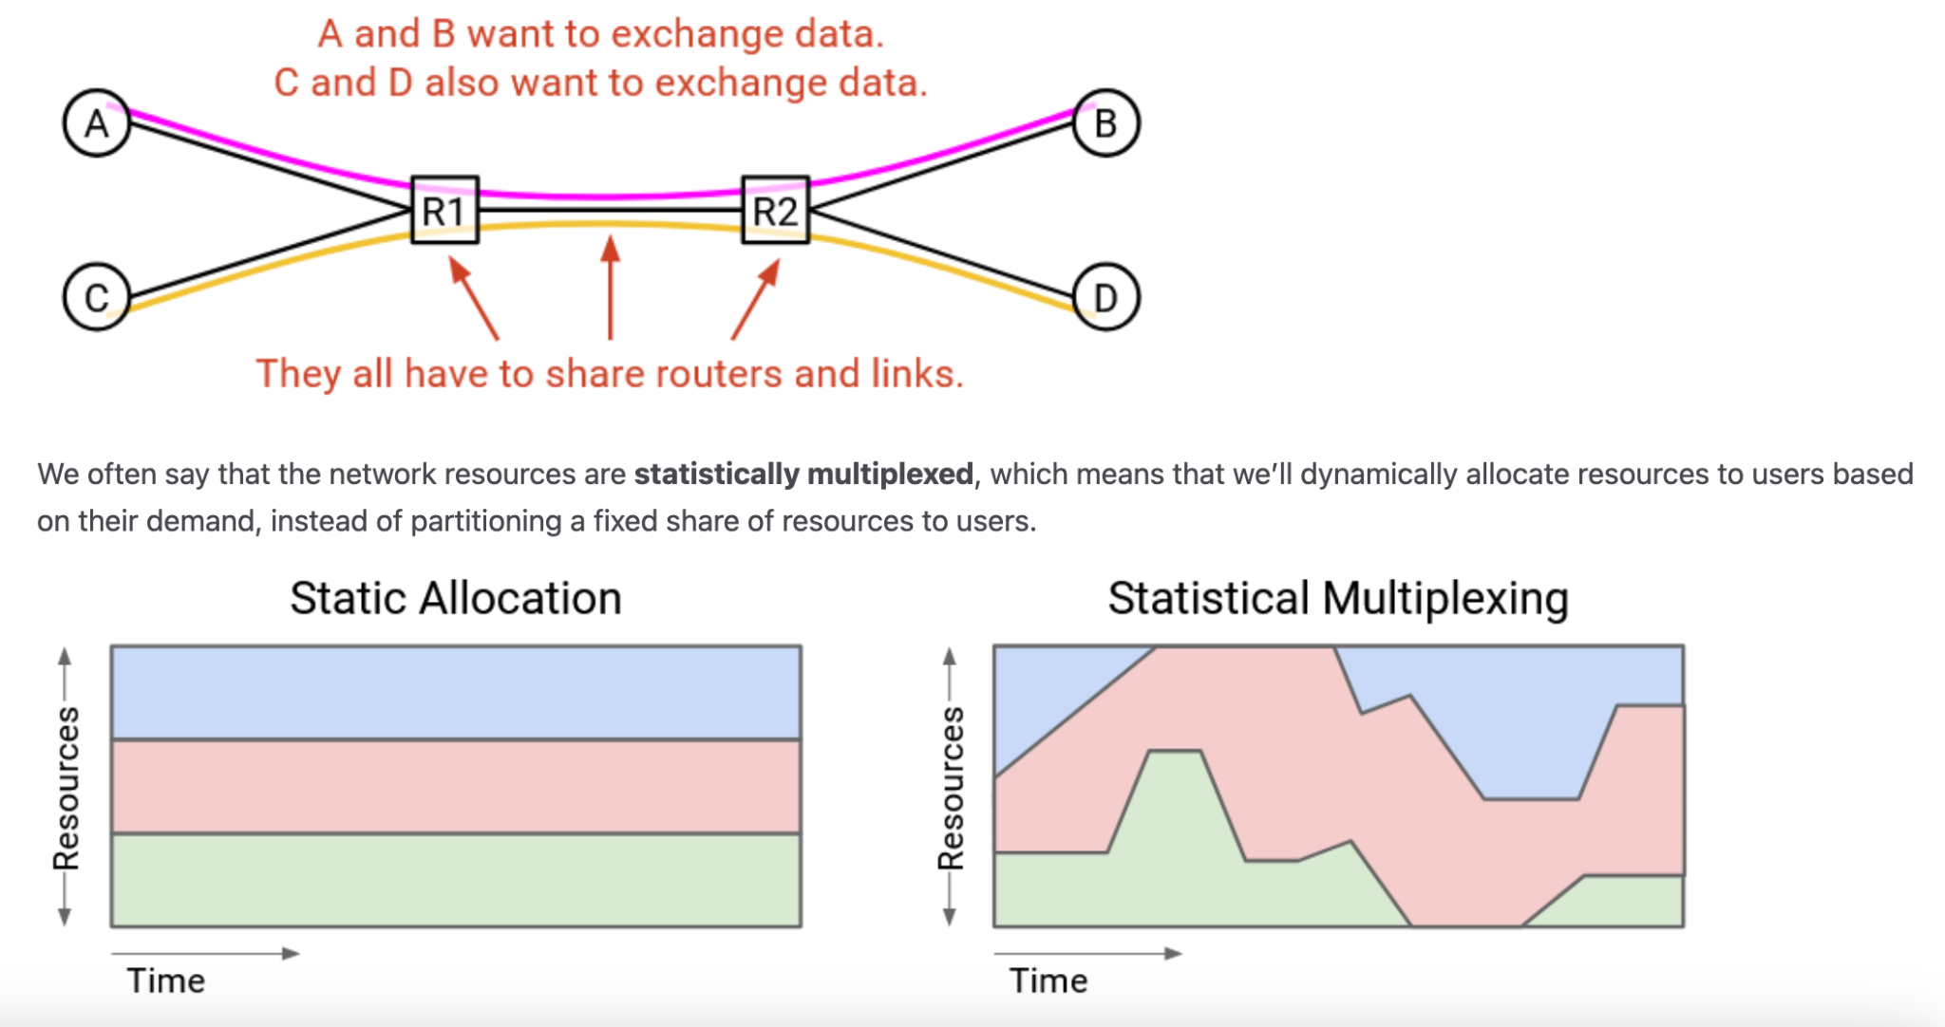
Statistical Multiplexing

Slide 23
Statistical Multiplexing
Sum of the peaks is always greater than the peak of the sums (peak of the aggregate). Usually much greater.
12
15
9
12
>=
15
15
36
15
12
9
9
Notes:
Statistically multiplexed means that we’ll dynamically allocate resources to users based on their demand, instead of partitioning a fixed share of resources to users.
The peak of the aggregate is actually closer to the sum of the average demands, which is much less than the sum of the peak demands. Statistical multiplexing is now everywhere in computer science. For example, in cloud computing, different companies might dynamically share resources in a datacenter.

Slide 24
Layering in the Open Systems Interconnected (OSI) Model
L7: Application
do the thing
L6: Presentation
(ignored here)
L5: Session
(ignored here)
L4: Transport
beyond delivery: (un)reliability, packet assembly, congestion control, ...
L3: Network
global delivery, best-effort
L2: Data link
local delivery, best-effort
L1: Physical
physical transfer of bits
Notes:
Distinguish local and global delivery

Slide 25
Layering in practice
L7: Application
HTTP(S)
SSH
Email (IMAP/POP)
...
L6: Presentation
L5: Session
L4: Transport
TCP
UDP
L3.5: research!
L3: Network
IP
L2: Data link
Ethernet
802.11 Wi-Fi
CAN bus
USB
L1: Physical

Slide 26
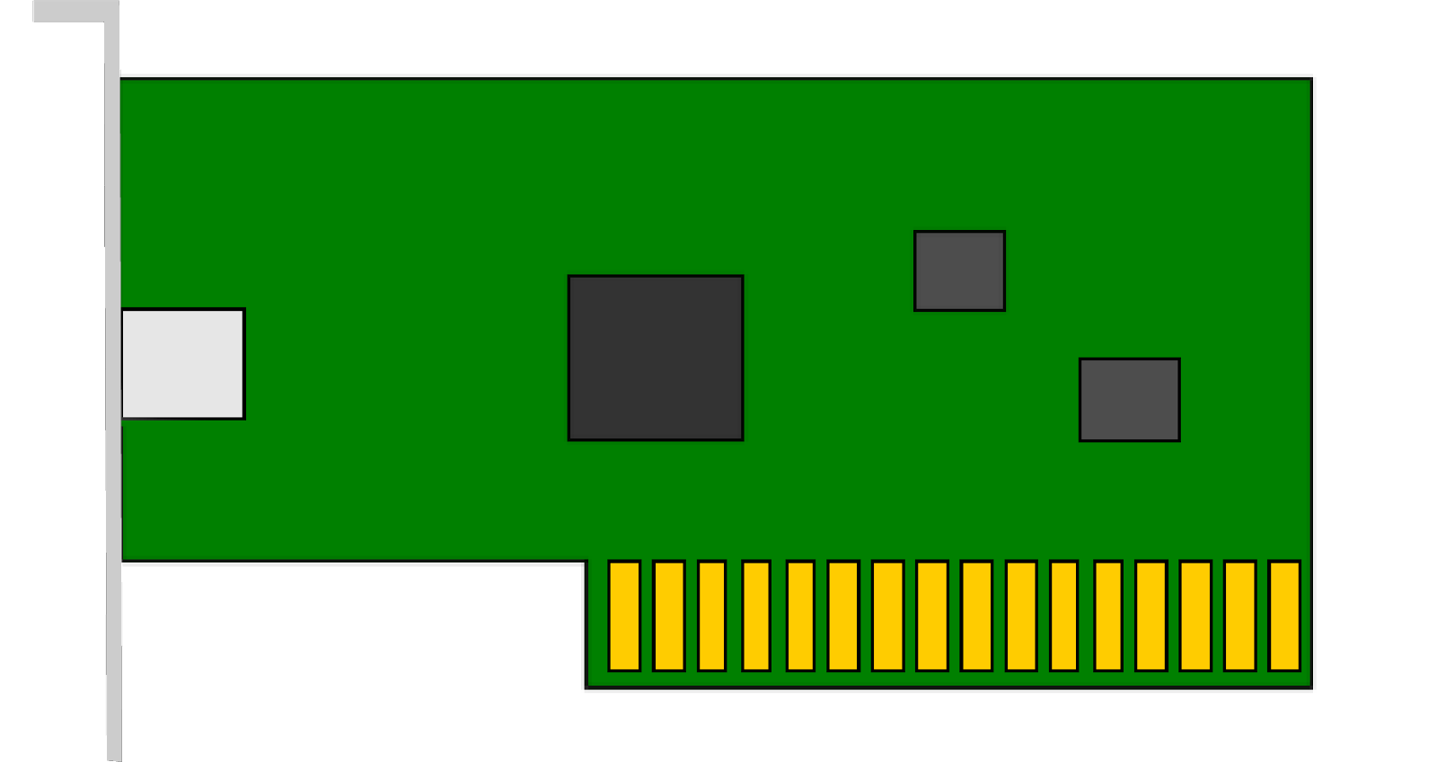
Sockets
Endpoint for sending or receiving data across a network
OS abstraction for connections
Allow L7 applications to operate on data streams (not packets)
Connect, listen, accept, send, receive
Open a socket between:
Source IP address : port
Destination IP address : port
app
app
app
Application
Port
Transport
Network
OS
(networking stack)
Datalink
Physical
NIC
(Network Interface Card)

Slide 27
Connection (the basic abstraction)
Pipes data between two processes (on different hosts)
Data flows both ways!
Process
Process
Process
Process
The Internet
Process
Process
Process
Process
Connection

Slide 28
Connection (the basic abstraction)
Data is sent simply as a stream of bits
Reconstruction of bits only at the endpoints
The Internet knows nothing* about what it’s transmitting!
* (unless you’re implementing security)
The Internet
Process
Process
Connection
Notes:
*** security

Slide 29
Connections
Two types of sockets
Server and Client
Servers listen for clients to connect to them
Wait until a connection is attempted
Accept and dispatch connection
Usually serving many clients at once
Clients initiate new connections to servers
Example
Server: berkeley.edu
Client: Your internet browser
Client
Client
Server
Client
Client

Slide 30
Connections
Hosts have addresses
Unique identifier (just like a street address)
Clients (different users) find servers with their addresses
Servers send data back with the client address
Example addresses ➔
1.2.3.4
5.6.7.8
Client
Client
10.20.30.40
Server
9.10.11.12
13.14.15.16
Client
Client
Are addresses enough to make this work?

Slide 31
Addresses aren’t enough
How does the client computer know which process (i.e. web browser) to deliver data to?
Server 1 Machine (5.6.7.8)
Client 1 Machine (1.2.3.4)
Server Process 1
Process 1
Process 2

Slide 32
Ports
Sockets are identified by unique IP:port pairs
A port is a number that the OS associates with a socket when it is created
i.e. sending to address “1.2.3.4:10000” would send data to the socket owned by Process 1
Server Machine
Client Machine (1.2.3.4)
Process 1
(Port 80)
Process 1
(Port 10000)
Process 2
(Port 20000)

Slide 33
Ports
Packets carry port number
Servers listen on a port
Which one depends on application
HTTP: 80
SSH: 22
Client process connects to
well known port
Client also has a port
Randomly assigned by OS
Used by OS to send data to correct process
Server Machine
Client Machine (1.2.3.4)
Process 1
(Port 80)
Process 1
(Port 10000)
Process 2
(Port 20000)

Slide 34
Worksheet
True or False
End-to-End Delay
Statistical Multi-What?

Slide 35
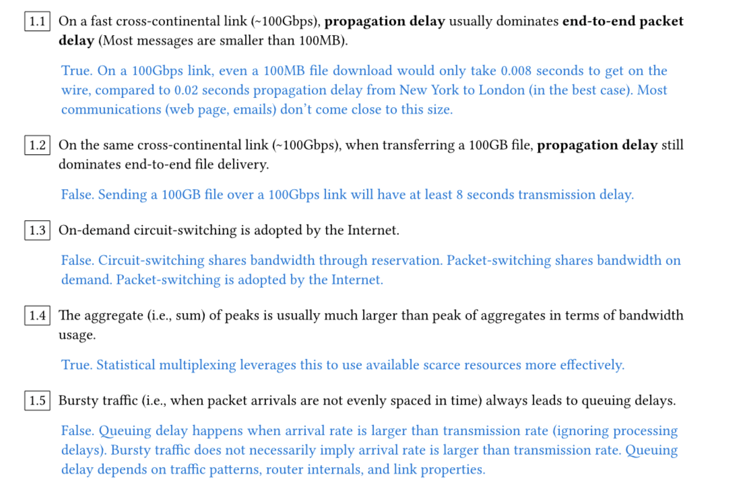
Question 1: True or False

Slide 36
Worksheet
True or False
End-to-End Delay
Statistical Multi-What?

Slide 37
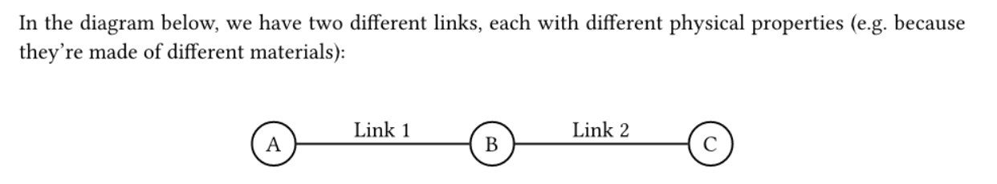
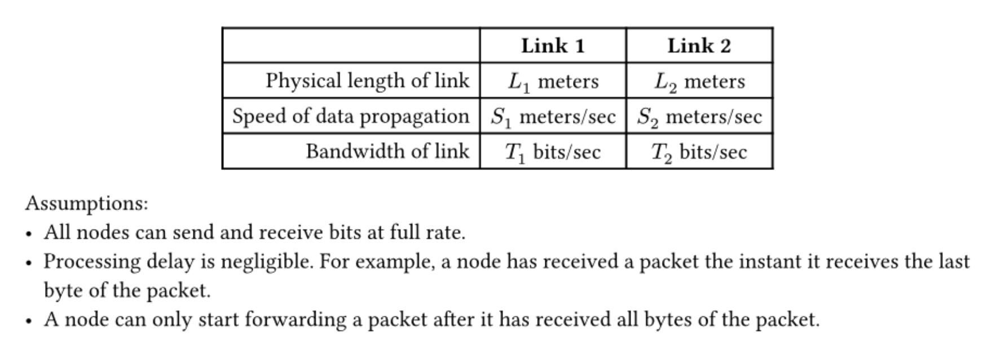
Question 2: End-to-End Delay

Slide 38
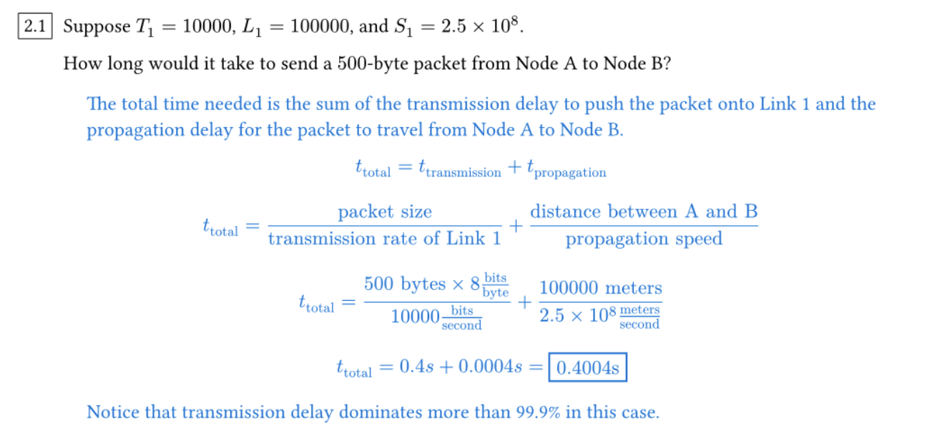
Question 2: End-to-End Delay

Slide 39
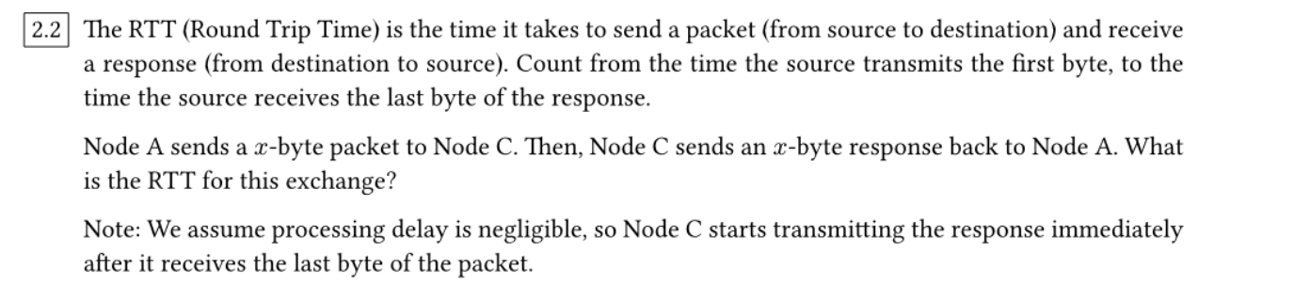
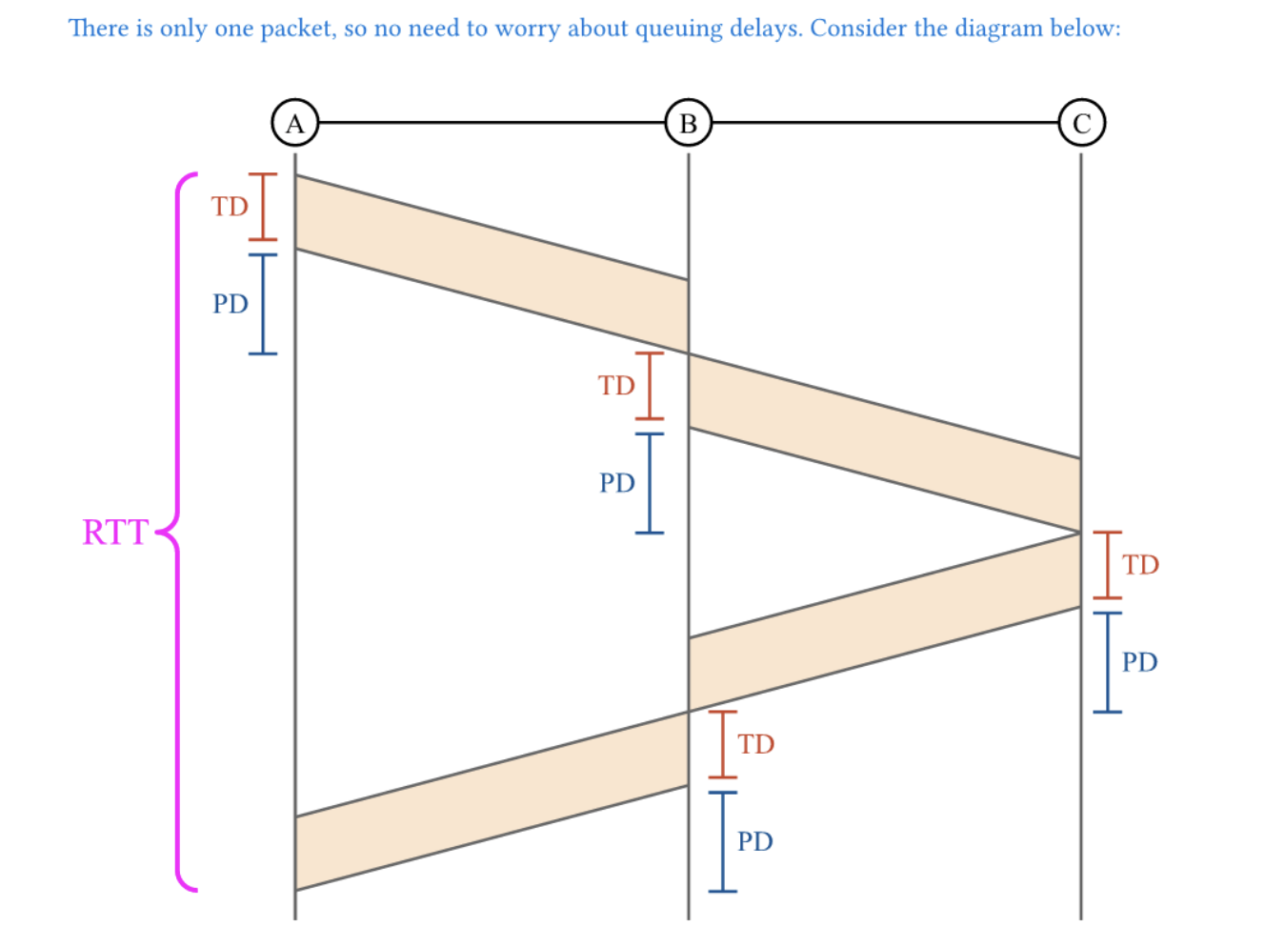
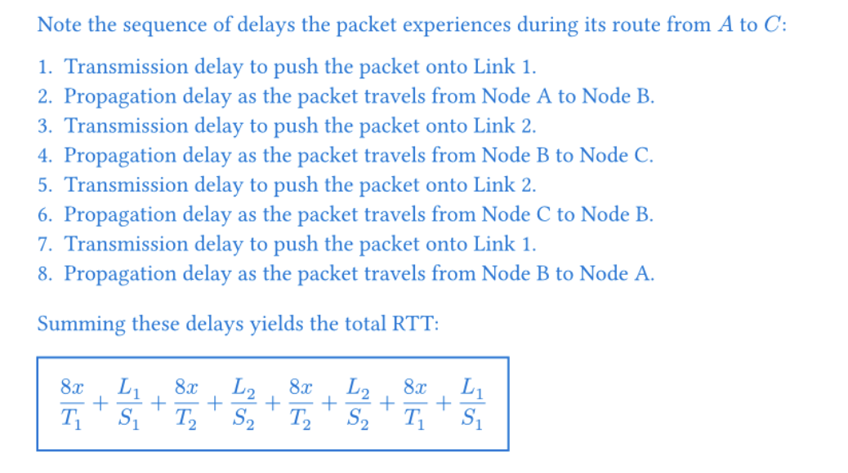
Question 2: End-to-End Delay

Slide 40
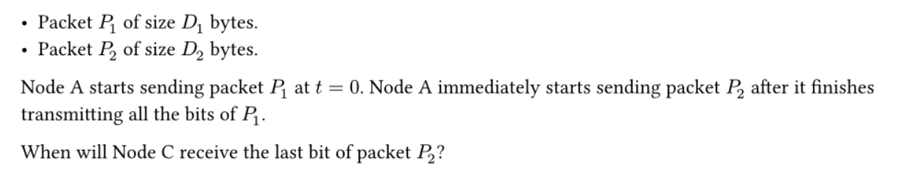
Question 2: End-to-End Delay

Slide 41
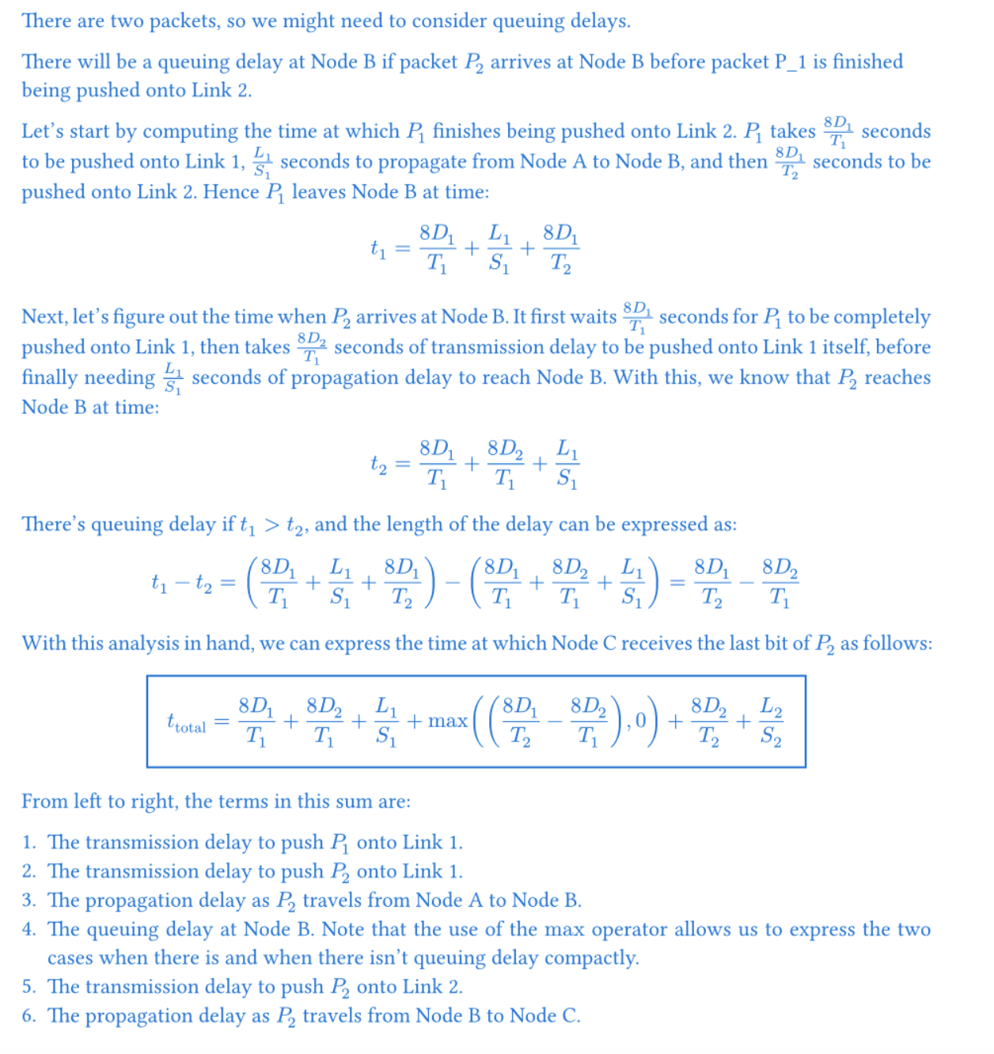
Question 2: End-to-End Delay

Slide 42
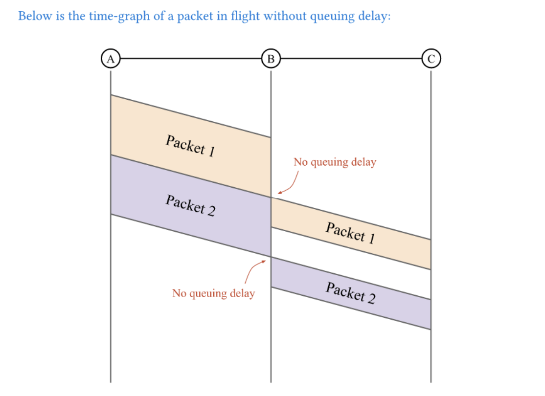
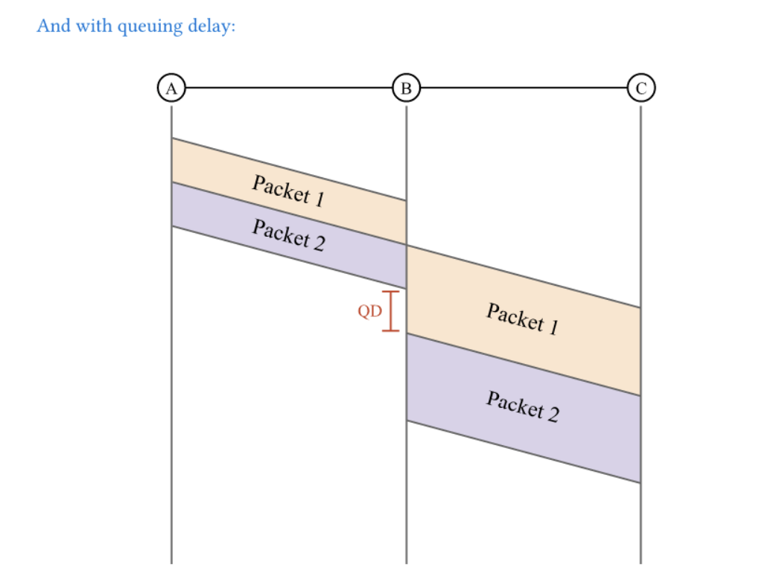

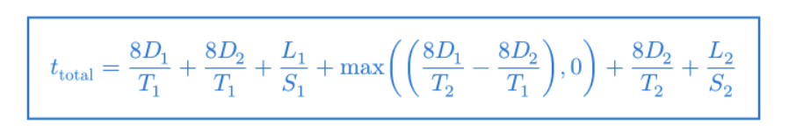
Question 2: End-to-End Delay
‼️

Slide 43
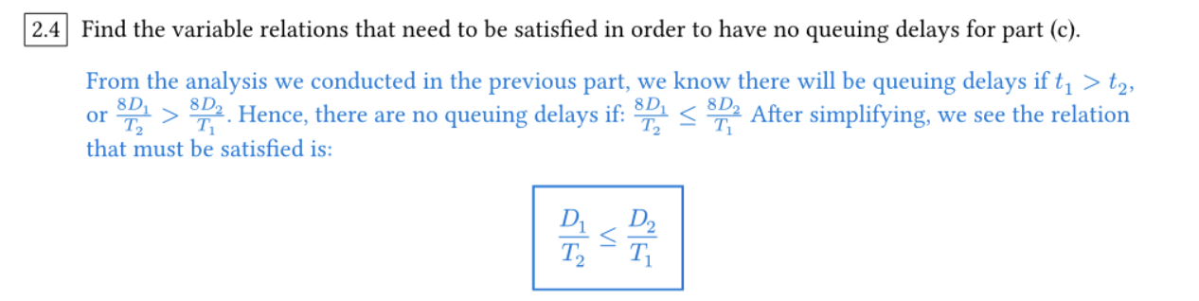
Question 2: End-to-End Delay

Slide 44
Worksheet
True or False
End-to-End Delay
Statistical Multi-What?

Slide 45
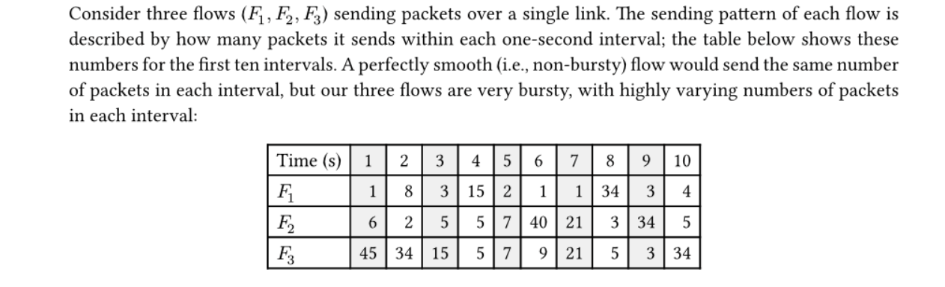
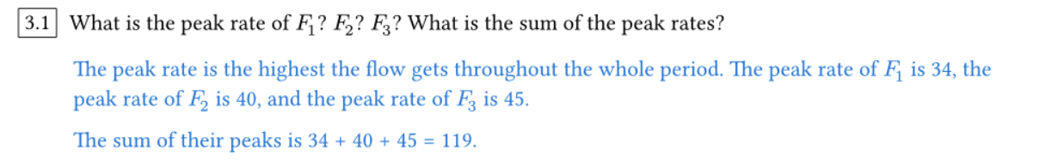
Question 3: Statistical Multi-What?

Slide 46
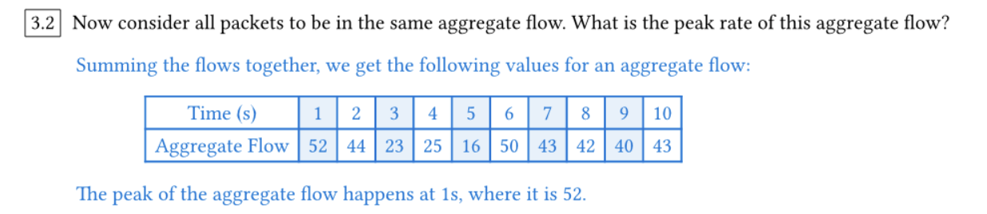
Question 3: Statistical Multi-What?

Slide 47
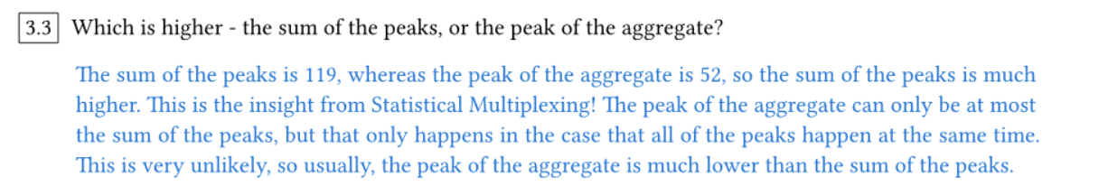
Question 3: Statistical Multi-What?

Slide 48

Questions?
Feedback Form: https://tinyurl.com/cs168-su25-disc-feedback

